Slide 1
Early Number Systems
Kyle Kasmiersky

Slide 2
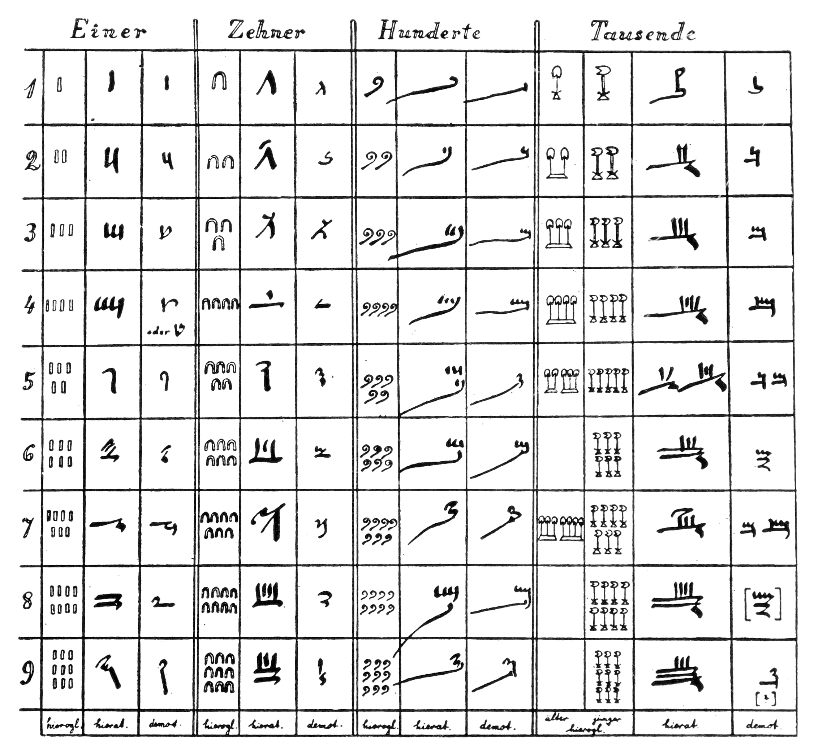
Egyptian numerals
1’s
10’s
100’s
1000’s
Used from 3000 B.C. until around 200 A.D.
Hieroglyphic and hieratic notation (first and second column of each group)
Repeated hieroglyphs indicated the magnitude of the powers of 10
Distinct hieratic numbers for each magnitude

Slide 3
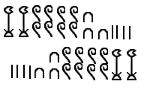
Egyptian numerals
Non positional number system
Hieroglyphics/Artifacts found with horizontal and vertical ordering

Slide 4
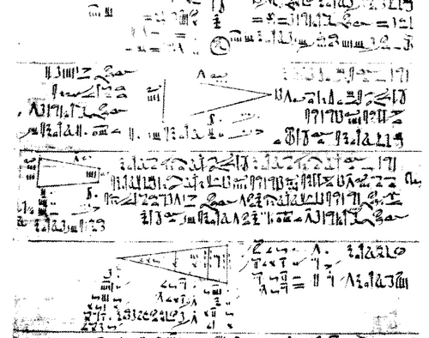
Egyptian numerals
Rhind Papyrus
Many of the attributes of the numeral system are archaic.
The mathematics, however, are very familiar.
The Rhind Papyrus (1550 B.C.) demonstrated arithmetic, geometry and early version of algebra.

Slide 5
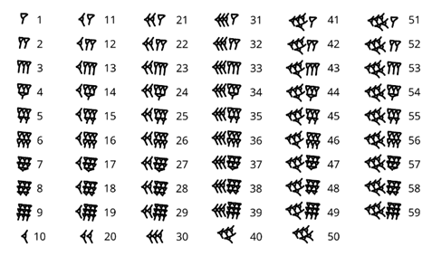
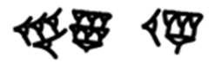
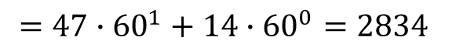
Babylonian Numerals
Originated around 1800 B.C.
From Babylonia, modern day Iraq.
Marks in clay, made with a rectangular stylus.
First positional number system
Numbers larger than 59 had multiple “digits”.
Formed a Sexagesimal system
$=47∙{60}^{1}+14∙{60}^{0}=2834$

Slide 6
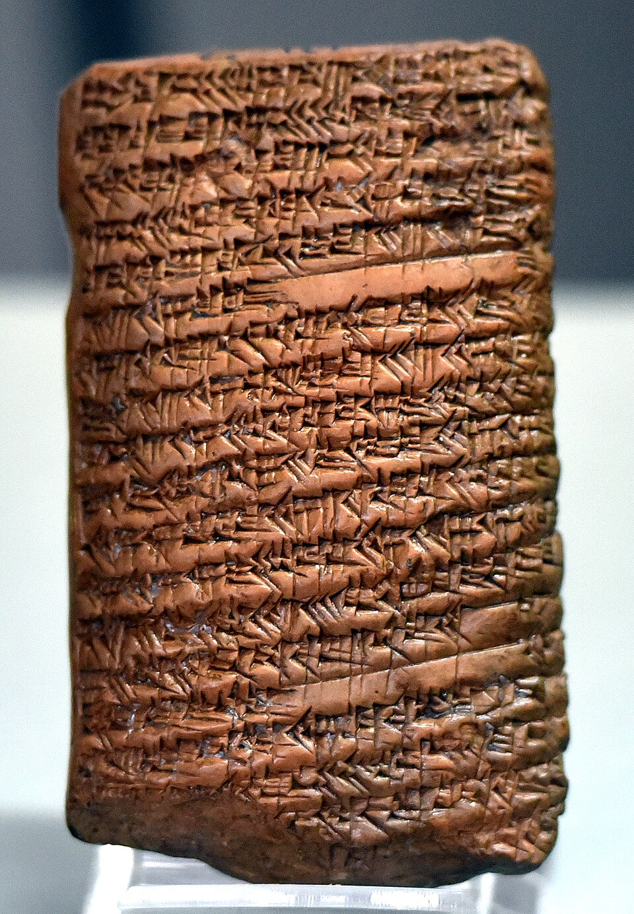
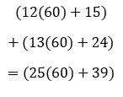
Babylonian Numerals
The positional ordering simplified arithmetic operations
Fractional values could be computed as whole numbers like modern decimal system
Base 60 fractional system exists today in circular degrees
Osama Shukir Muhammed Amin FRCP(Glasg)

Slide 7
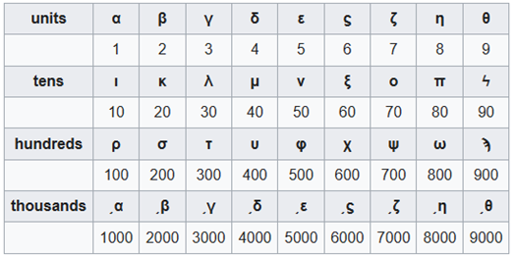
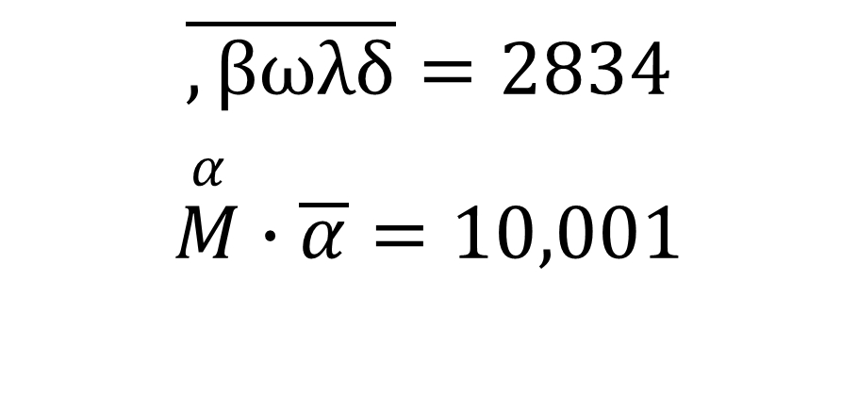
Greek Ionic Numerals
Replaced attic numerals around 400 B.C.
First widely used alphabetic numerals
Shorter numbers and positional system made arithmetic much easier
$$\overline{,βωλδ}=2834$$
$$\overset{α}{M}∙\overline{α}=10,001$$

Slide 8
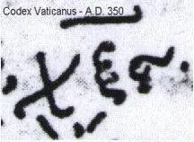

Greek Ionic Numerals
Letters in Greek words were attributed to their numbers
Called isopsephy, numerical values were summed or taken as is
In Greek, “Nero” is equivalent to “He killed his mother” which led people to believe it was true.
Most famously in the Greek manuscripts of the new testament as the mark of the beast.
$$\overline{χξς}=666$$

Slide 9
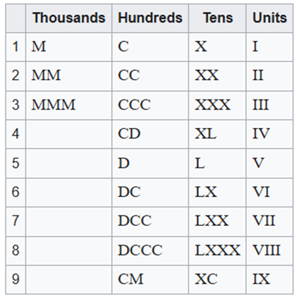
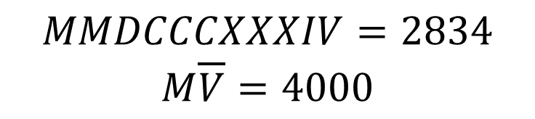
Roman Numerals
Origin of the roman numerals is debated, as it evolved significantly over time.
It developed in-between 800 B.C. and 50 A.D.
Based on the Etruscan numerals
Base 10 system, subdivided at 5th 10^{th’s} place.
Numbers with an overbar have a 1000 multiplier
$$MMDCCCXXXIV=2834$$
$$M\overline{V}=4000$$

Slide 10
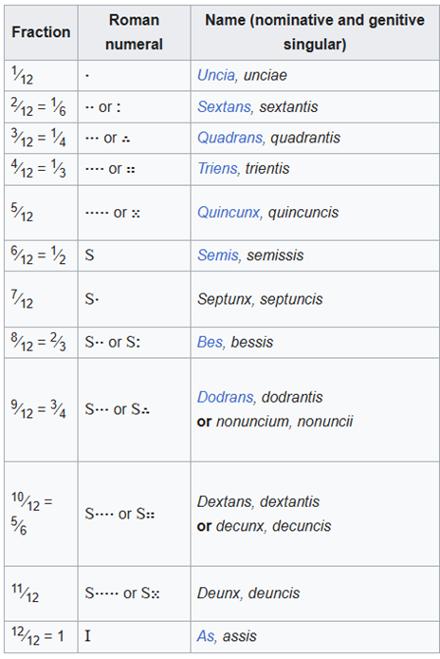
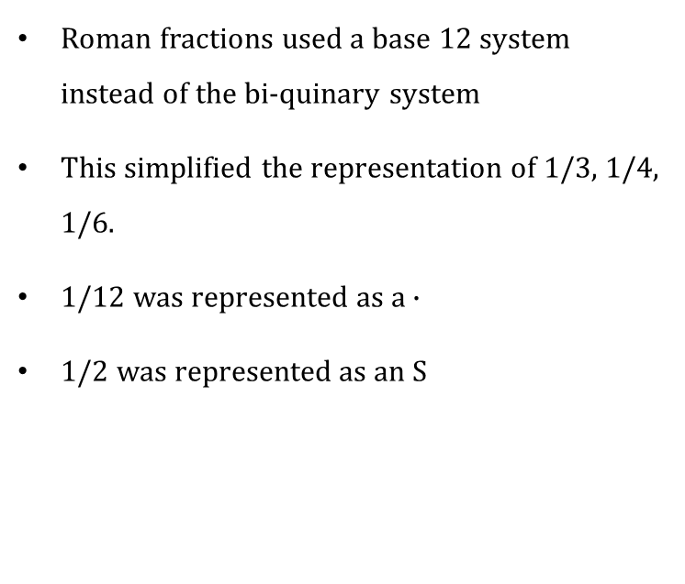
Roman Numerals
Roman fractions used a base 12 system instead of the bi-quinary system
This simplified the representation of 1/3, 1/4, 1/6.
1/12 was represented as a $∙$
1/2 was represented as an S

Slide 11
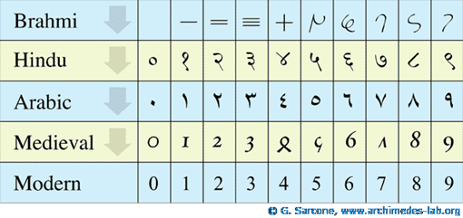
Hindu/Arabic numerals
First invented by Hindu mathematicians in 100 to 400 A.D.
Adopted by Arabic mathematicians in 800’s
Simpler than ionic solution for digits
Introduced zero as a number
Arabic mathematicians develop fractions

